Slide 1

Predicting the Best Team: Fantasy Football
Data Science Project
by Zachary Ang
2 Apr 2016

Slide 2
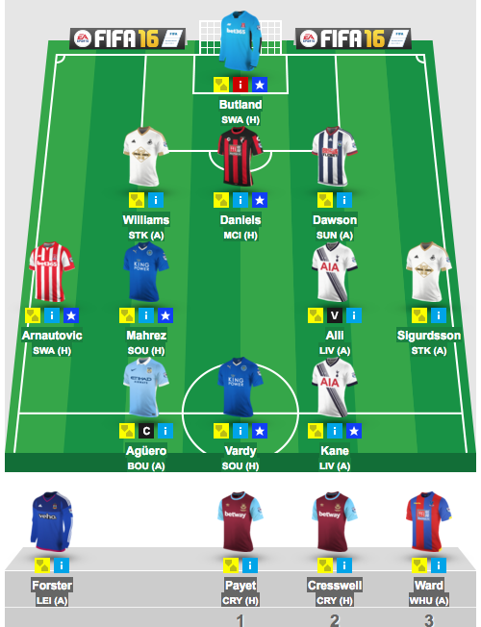
How Fantasy Football Works
Pick 15 from 550 players every week
2 GK, 5 DEF, 5 MF, 3 FWs
Budget cap of £100m
Only 11 players per week score points
Captain scores double points

Slide 3
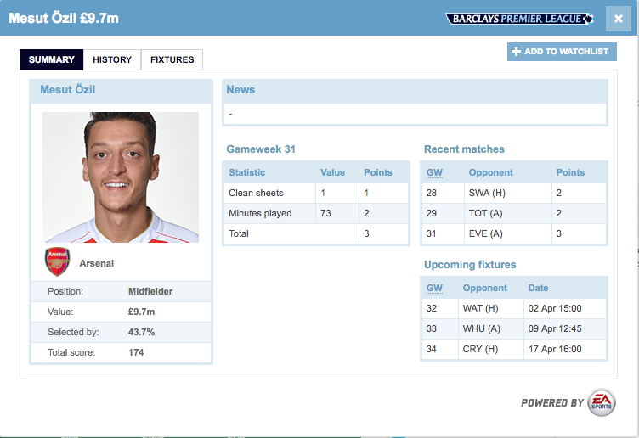
Player data contains basic information
Personal Attributes
Team
Name
Cost
Position

Slide 4
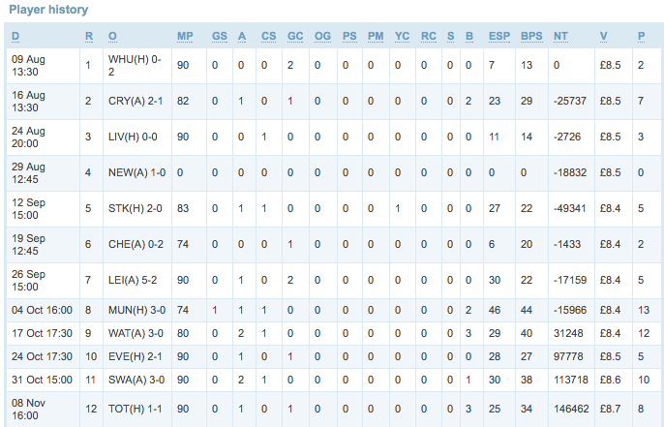
Performance data goes back to the first gameweek

Slide 5
Scoring is based on what players do in real life
Score a Goal
Yellow Card
Forwards
Assist a Goal
Red Card
Midfielders
Play 60 Minutes or more
Miss Penalties
Defenders
Bonus Points
Own Goals
Keep a Clean Sheet
Concede 2 goals
Goalkeepers
Make 3 Saves/ Penalty Save

Slide 6
Preliminary Analysis
Correlation matrix : No strong multi-collinearity
Simple linear models
Simple classification models

Slide 7
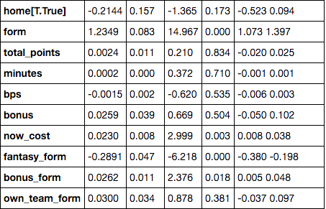
Form Matters!
p-value

Slide 8
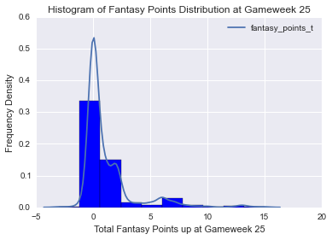
Distribution of Fantasy Points are Skewed

Slide 9
Problems!
Different types of players have different scoring
Regression or Classification?
How to specify “form”?
How to deal with non-normal data?
How to narrow down from 550 to just 15?

Slide 10

Approach
550 players
GK
DEF
F( X; r, θ)
Optimise
MF
FW
Tune r, θ till best candidate model is reached

Slide 11
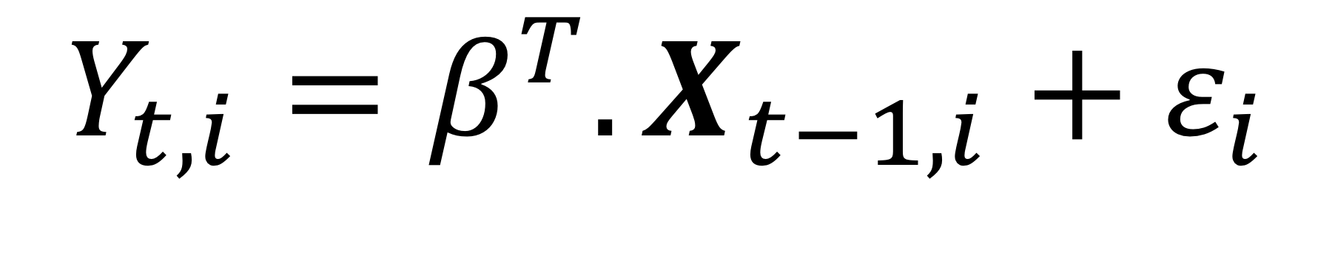
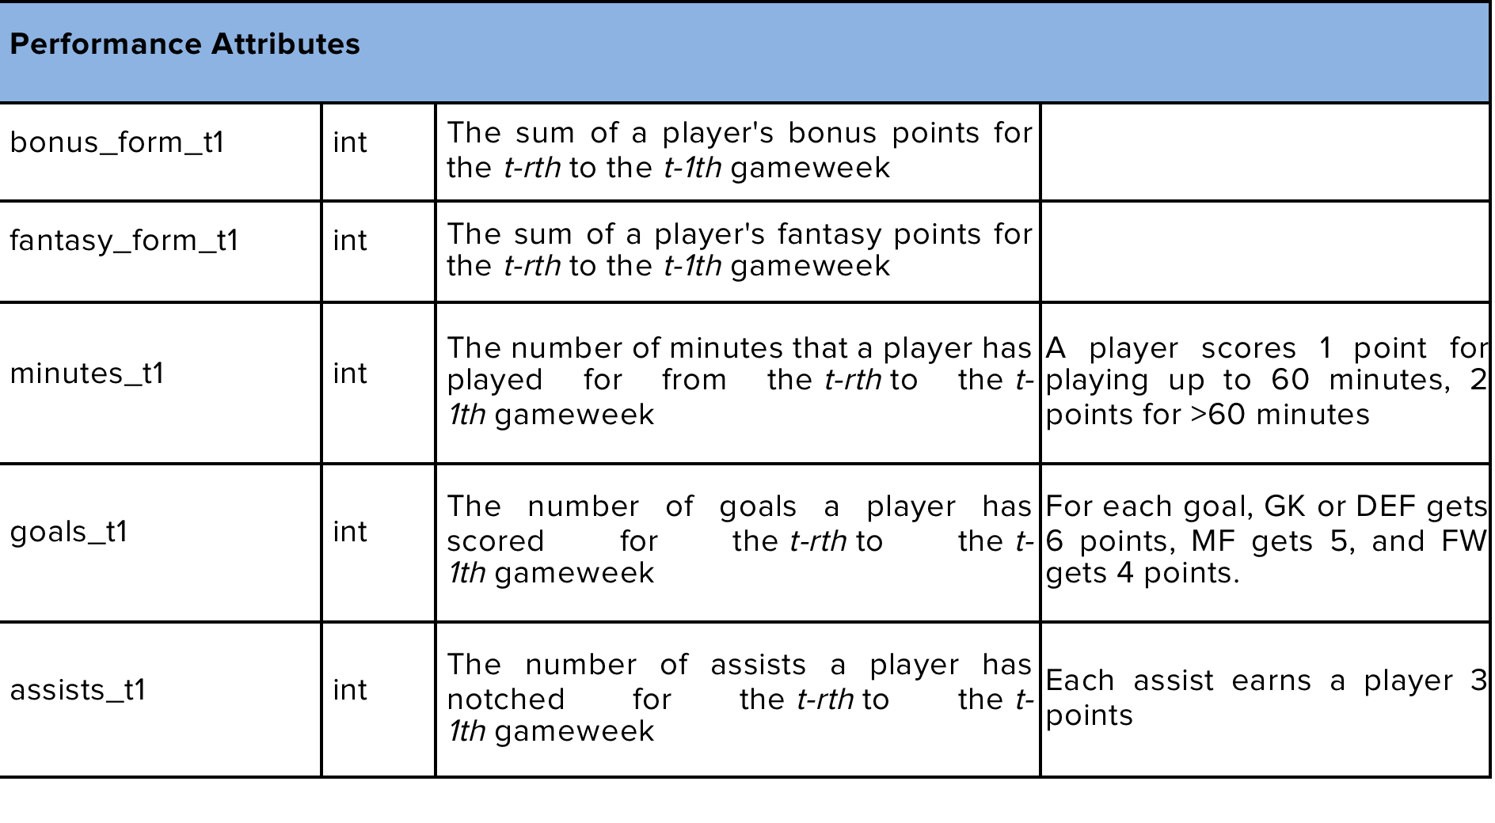
Model Specification & Feature Selection

Slide 12
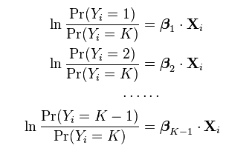
Model Selection
Simple Linear Regression
Multinomial Logistic Regression

Slide 13
Model Selection
Random Forest Regressor
Non Parametric
Predicts continuous output
Collection of decision trees
Fix number of trees = 20

Slide 14
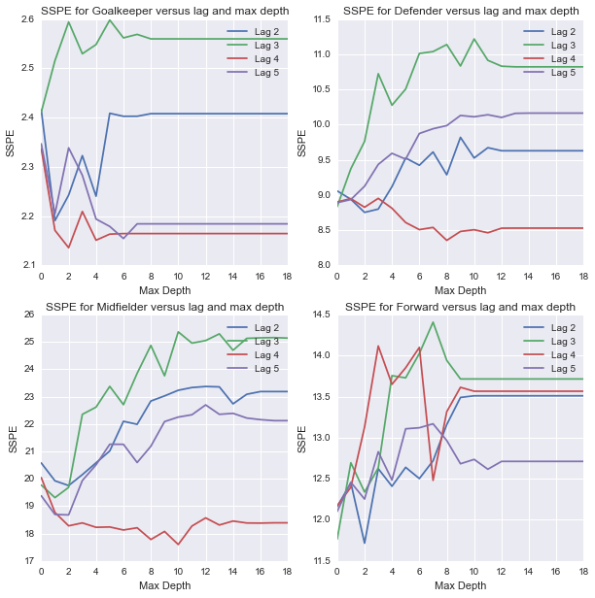
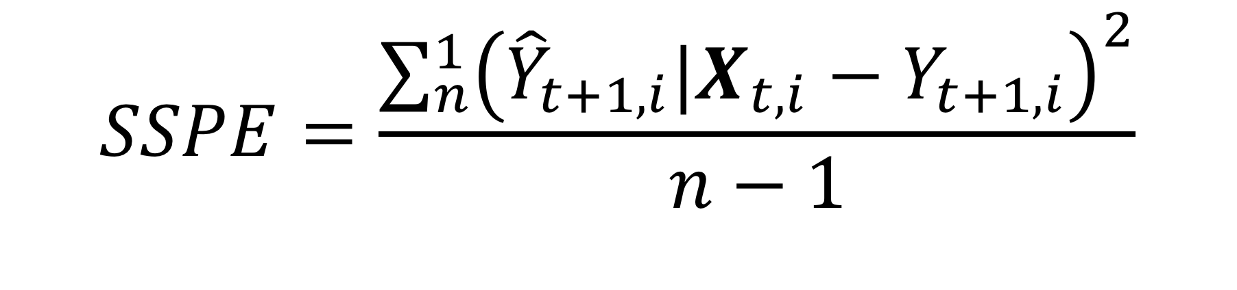
Use Sum of Squared Prediction Errors for Model Selection

Slide 15
Modeling Parameters
Max Features: Unconstrained
Max Depth: GK=4, DEF=8, MF=10, FW=7
Lag length r = 4

Slide 16
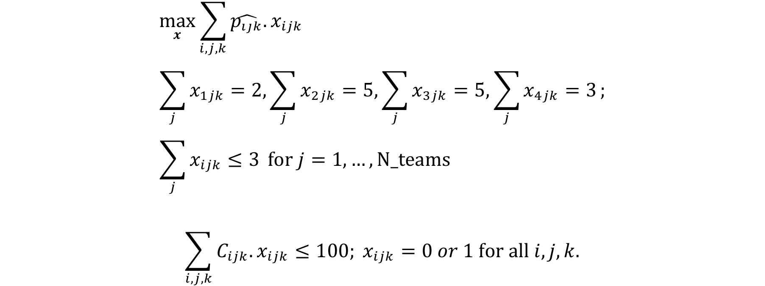
Optimisation
*Credits to Martin Eastwood

Slide 17
Results

Slide 18
If I had used my model, I would be…
Top of my mini-league amongst 12 friends
86th in Singapore (~8000 jump)
6000th worldwide (~860,000 jump)

Slide 19
Future Work
Optimise subject to transfer cap
Model Auto-Correlation
Incorporate more features

Slide 20
Thank You

